Slide 1
R workshop
The next few days will introduce you to using R and Rstudio to interact with and plot data.
The data we will work with later in the week is related to prediction of the risk of poliovirus in Pakistan.
The next few slides will introduce how this data is used in risk assessments.

Slide 2
Risk factors and short-term projections for serotype-1 poliomyelitis incidence in Pakistan: A spatiotemporal analysis
Molodecky et al. 2017 Plos. Med.

Slide 3
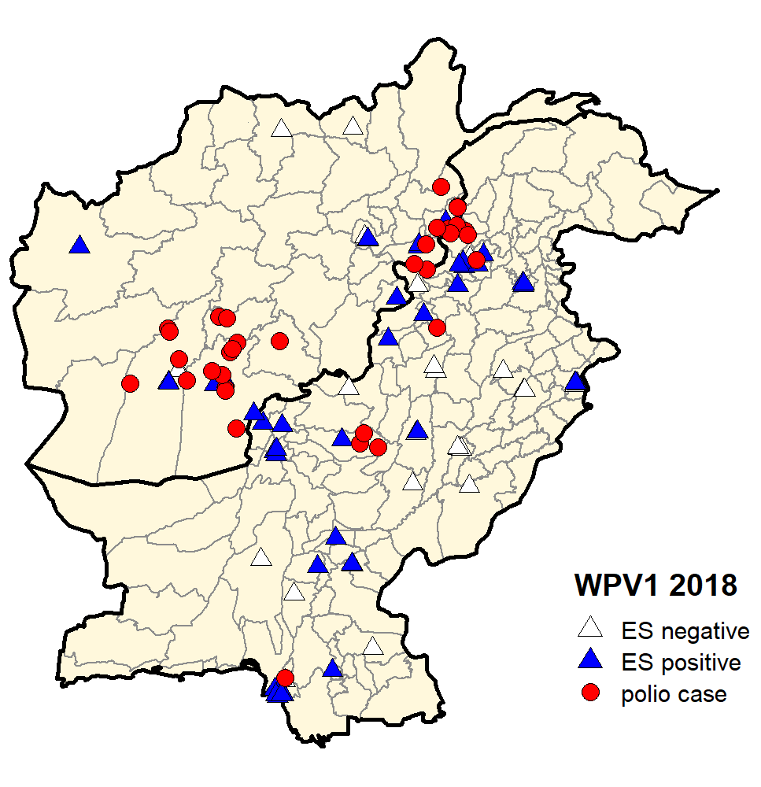
Background
Pakistan and Afghanistan represent the last remaining cluster of wild poliovirus transmission globally. No cases have been seen in Nigeria since 2016
RI and SIAs are the key interventions in Pakistan to interrupt transmission
Accessibility issues are known – estimating risk in inaccessible areas is hard but they also represent risk of transmission to surrounding areas
OPV immunogenicity poorer in Pakistan – multiple doses needed
Targeting interventions important to maximise utility of doses

Slide 4
Global WPV1 Cases, 2009–2019*
Consistent decline in confirmed cases 2014-2017
Updated from presentation by Natalia Molodecky, WHO

Slide 5
Model aim
This work aimed to include movement data in polio risk models to see if polio spread could be better estimated.
Risk models are used to plan SIAs so accuracy is important to the interruption of WPV transmission.

Slide 6
Basic parameters
Vaccination history of AFP cases – reported vaccine doses of non-polio AFP cases divided by number of SIA campaigns in their district between birth and paralysis
RI coverage - % of children receiving 3 RI doses of OPV
Non-polio AFP rate – marker of surveillance intensity
Cases in the same spatial unit
Population and density of each spatial unit – number of individuals important to risk of spread
Population living in poverty
Precipitation
Pop^{n} immunity

Slide 7
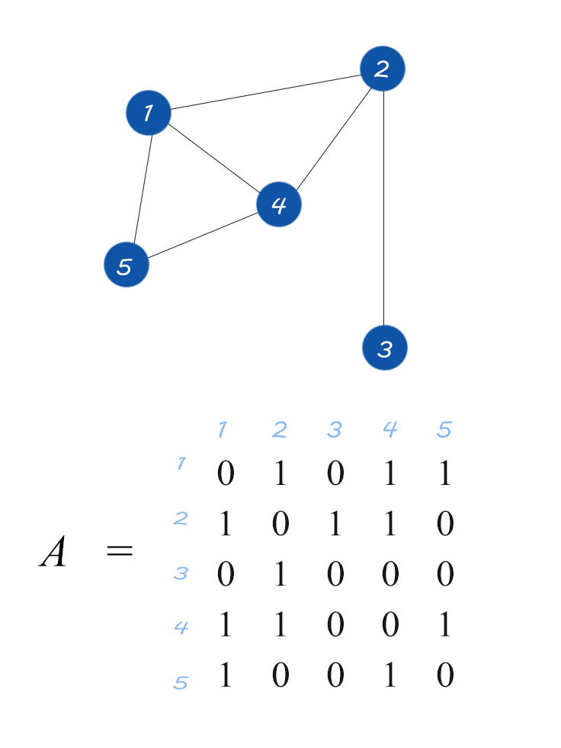
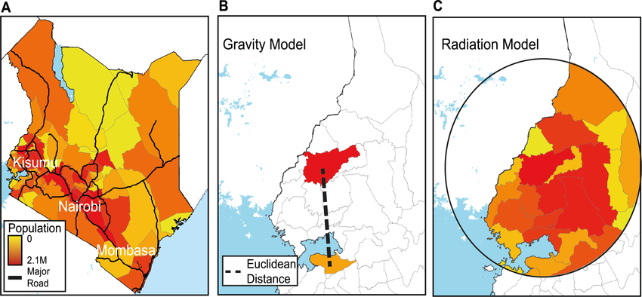
Movement models
First order adjacency
Gravity and radiation models
Wesolowski et al. Plos Comp. Biol. 2015
Notes:
First order adj- any district directly bordering the source district has 1 in the matrix – others have 0
Gravity model – incorporates the 2 districts of interest and their relative populations and the direct straight line distance between them
Radiation model – incorporates the 2 districts of interest and the population of any district within the same straight line distance to the source population
This weights the likelihood of movement between the populations by incorporating the likelihood of movement to any other district with the same travel distance
These are all simple models of population movement – not taking in to account terrain features, road networks, ethnic associations etc.

Slide 8
Movement models
Extensions to these movement models incorporated:
Population density in the radiation model – a small district with high population density is more likely to attract a migrant than a large district with the same population.
Travel time in the radiation model – rather than direct distance we can use road network maps etc to estimate real world travel time.
Mobile phone data in the gravity model – mobile phone data gives an indication of where people are travelling in reality to fit the model to.

Slide 9
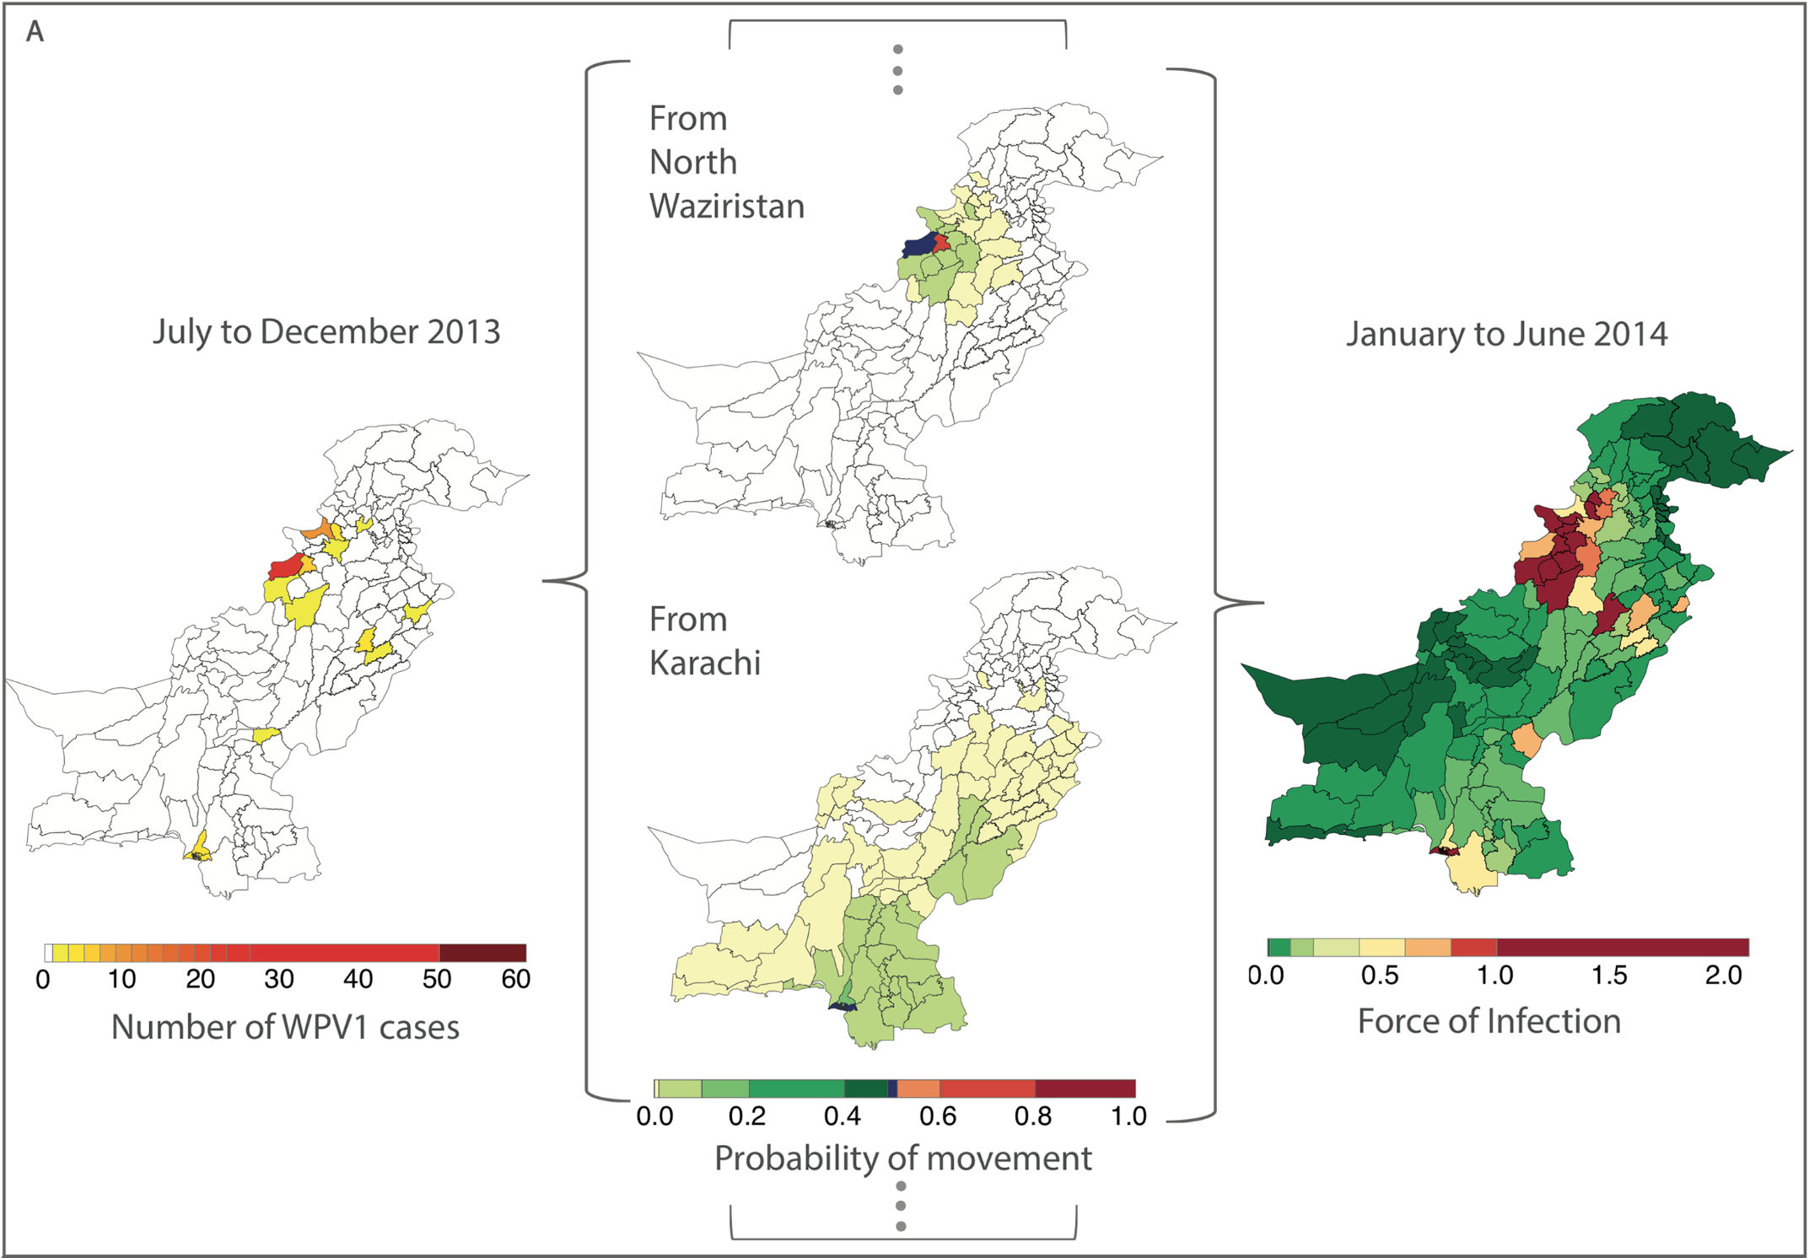
Force of infection

Slide 10
Force of infection
“The rate at which susceptible individuals acquire disease”
This depends on a number of factors such as likelihood of contacting infected individuals, probability of transmission on contact and the number of infected individuals.
Therefore population, number of local infections, total number of infections, vaccination coverage etc. all contribute to risk of disease.

Slide 11
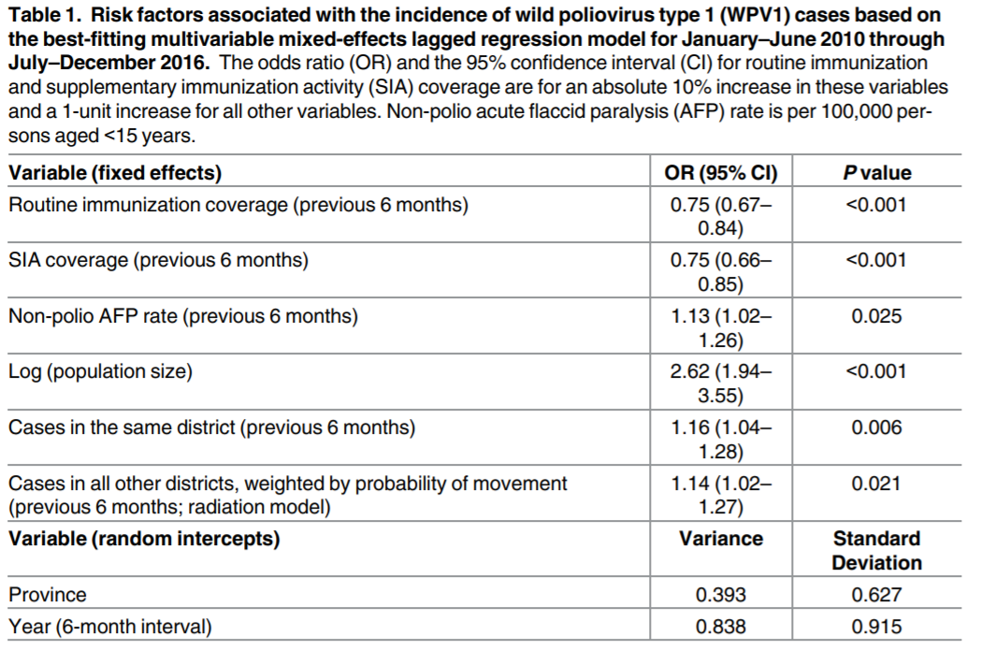
Results
Notes:
For 6 month periods after the start of 2016 out of sample predictions fitted on the previous data were compared to actual reported numbers of cases.
Calculating population immunity from RI and SIA coverage was redundant in the final model and including both individually resulted in better fit

Slide 12
Interpreting these odds ratios
Measure of association between an exposure and an outcome.
These represent the change in the odds of a polio case depending on a 10% change in RI or SIA coverage or a 1 unit change in the other parameters.
Odds below 1 indicate a negative association where an increase in exposure leads to a decrease in the effect of interest.

Slide 13
Why were these parameters important?

Slide 14
Routine immunisation coverage

Slide 15
Routine immunisation coverage
Negative association
This represents both a portion of population immunity to poliovirus alongside SIA coverage and a measure of the efficiency of the health systems in the area to provide 3 doses of vaccine to children.
Together with SIAs, low coverage can be an indicator of vaccine refusal

Slide 16
SIA coverage

Slide 17
SIA coverage
Negative association
This association suggests that greater SIA coverage leads to a decrease in risk of poliovirus in the population.
This suggests that SIAs carried out in response to higher risk are effective in reducing this risk.

Slide 18
Non-polio AFP rate

Slide 19
Non-polio AFP rate
NPAFP rate is a marker of:
Sampling rate for poliovirus cases – there is increased chance of reporting a case where more surveillance is being carried out.
NPAFP reporting also tends to be higher in areas where recent campaigns have been carried out due to increased surveillance by teams in the region.

Slide 20
Log population size

Slide 21
Log population size
Log is taken of population size to decrease the magnitude of change between urban and rural areas, this allows odds ratios to be calculated more easily.
Association of population size with polio risk is expected as there is more likelihood of being in contact with an infected person or of an infected person coming to your region if it is a major population centre.
Sewage systems and sanitation in large urban areas often also serve a larger population leading to increased risk of contact with contaminated water if the sewage network is not contained

Slide 22
Cases in the same district

Slide 23
Cases in the same district
Cases in the same district represent local risk of disease, you are more likely to come in to contact with an individual or water contaminated by an individual if they are in close proximity to you.

Slide 24
Cases in other districts

Slide 25
Cases in other districts
As the whole country is considered one population, there is an increased risk for everyone in the population when cases are reported.
As there is movement between populations it is possible for long distance transmissions to occur.
It is also possible that cases in bordering districts represent short distance transmissions.

Slide 26
Updated analysis on 2017 data
David Jorgensen

Slide 27
2017 analysis
Included Afghanistan as key risk predictions for border regions are likely to be incorrect when not accounting for cross-border transmission of virus.
Included LQAS data alongside NPAFP estimates of vaccination coverage.

Slide 28
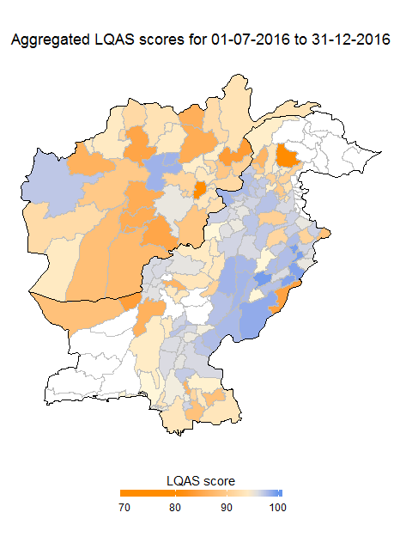
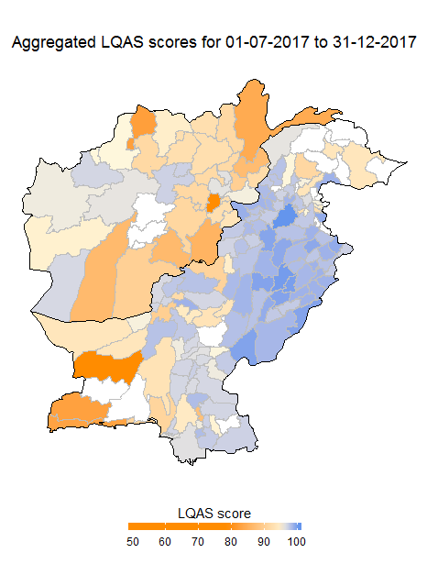
LQAS Data

Slide 29
Data
The models were fitted on binary incidence over time 01-01-2013 to 30-12-2017
SIA coverage data:
LQAS – discretised using the median (Previous 6 months)
AFP – Split in to quartiles (Forward 6 months)
Other parameters from previous work
NPAFP rate (Previous 6 months)
RI coverage (Previous 6 months)
Cases in the same district (Previous 6 months)
Population size (worldpop 2015 estimate)
Between district force of infection (Previous 6 months)
BYM model with neighbour joining matrix
Random walk over time (province, region and global)

Slide 30
Results: 01-01-2017 to 30-06-2017

Slide 31
Issues with these risk analyses
Models are always a simplification of reality, a number of other factors for which data is not available likely also contribute to risk of polio cases.
Poliomyelitis cases, reported in these analyses, represent only a small fraction of those infected with poliovirus, due to the likelihood of contracting paralytic disease polio cases are usually clustered in the regions of high transmission but transmission is able to persist in other regions through asymptomatic individuals and the environment.

Slide 32
All of these risk analyses were carried out in R!
The next few days will teach you the basics of R up to plotting specific polio data from Pakistan. These risk analyses show how the data we will be plotting contribute to the risk of polio infection.
Being able to clean and plot the input data for these type of models is half the work. Matching your data columns, aggregating data and visualising it give a good indication of specific risks without running these complex, national level models.

Slide 33
Where we are going with this course
The majority of the course will focus on basic plotting and data handling with R, towards the 3rd day you will start to see these skills come together to recreate plots with important predictors of polio risk.

Slide 34
Surveillance

Slide 35
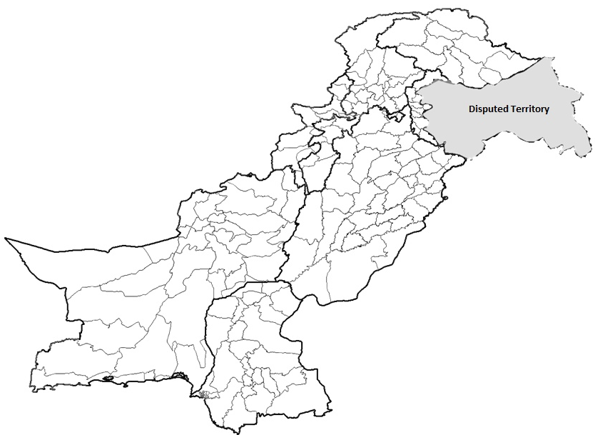
Polio Cases 2019*
P1 = 45
Provincial Boundary
Districts Boundary
Cases randomly placed in districts
* Afp.rec Data as of 15-07-2019
Notes:
35

Slide 36
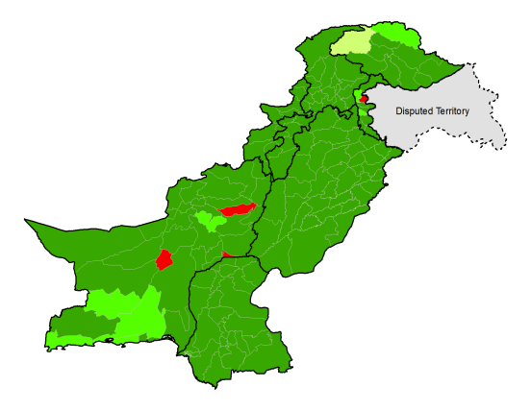
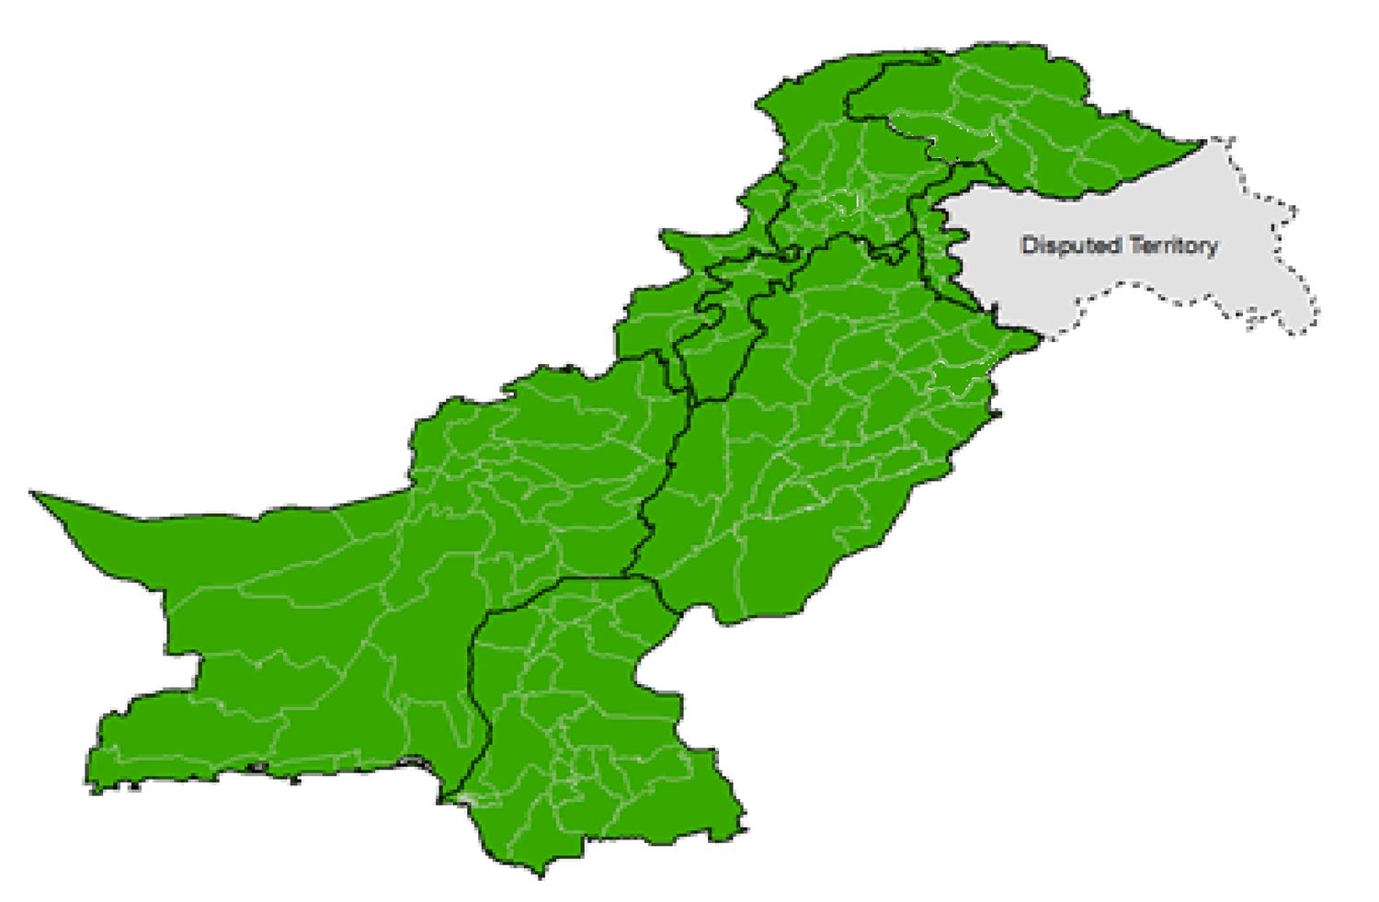
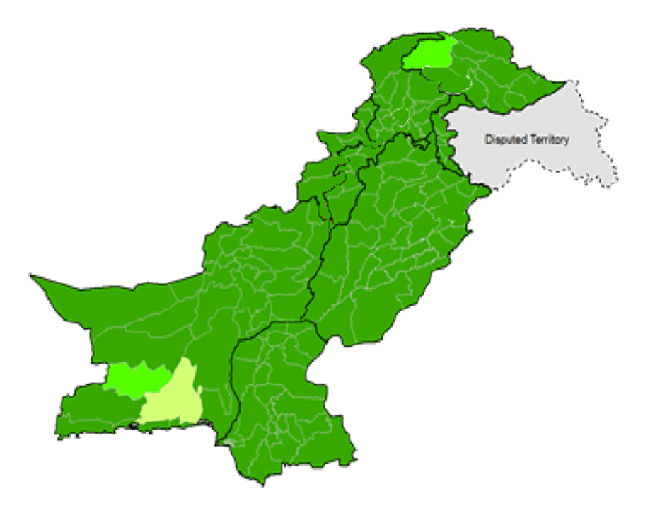
Non-Polio ^ AFP Rate by District
2017
2018
2019
Non-polio AFP rate Up to Week No. 28 ended on 13th Jul, 2019
^Annualized

Slide 37
Graph 1:Distribution of AFP Cases by Month, Pakistan 2015-2019*
Cases (n)
2015
2016
2017
2018
2019
* Afp.rec Data as of 15-07-2019
Notes:
37

Slide 38
Environmental Sampling Results 2015-19* pakistan

Slide 39
Micro Plan Quality Assessment

Slide 40
Summary of MPQA results
SUMMARY OF MPQA RESULTS
Micro Plans of Tier-1 Districts from Karachi town, Quetta Block and Peshawar/Khyber are passed
Substantial gaps identified primarily in Balochistan and pockets of KP and Sindh

Slide 41
Intra campaign data

Slide 42
Household cluster, Dec18-Jun19

Slide 43
Admin coverage
Province | Target Children | % Coverage HH | % Total Children Vaccinated
AJK | 703428 | 86 | 99
BALOCHISTAN | 2541690 | 86 | 96
GB | 237416 | 88 | 100
ISLAMABAD | 347932 | 79 | 102
KP | 5885380 | 89 | 101
KPTD | 895589 | 99 | 104
PUNJAB | 19224769 | 84 | 105
SINDH | 8889020 | 90 | 101
TOTAL | 38725224 | 87 | 103
Province | Recorded Missed Children covered after revisits (same day) |  |  |  | Still Missed Children
 | Covered Refusals | % Among Recorded | Covered Missed | % Among Recorded | Still Refusals | % Among Targeted | Still Missed | % Among Targeted | % Among Recorded
AJK | 13 | 12.26 | 12590 | 43.44 | 69 | 0.01 | 257 | 0 | 0.9
BALOCHISTAN | 17816 | 51.67 | 94273 | 39.02 | 3884 | 0.15 | 41032 | 1.6 | 17
GB | 29 | 100 | 3655 | 38.57 | 0 | 0 | 464 | 0.2 | 4.9
ISLAMABAD | 867 | 57.72 | 29263 | 61.07 | 185 | 0.05 | 2523 | 0.7 | 5.3
KP | 23532 | 42.19 | 350229 | 48.35 | 7504 | 0.13 | 26361 | 0.4 | 3.6
KPTD | 681 | 34.85 | 51975 | 45.07 | 94 | 0.01 | 4408 | 0.5 | 3.8
PUNJAB | 2032 | 46.7 | 1125821 | 48.23 | 458 | 0 | 22832 | 0.1 | 1
SINDH | 75002 | 29.47 | 787309 | 50.64 | 90701 | 1.02 | 157822 | 1.8 | 10.2
TOTAL | 119972 | 34.02 | 2455115 | 48.55 | 102895 | 0.27 | 255699 | 0.66 | 5.06

Slide 44
Missed children analysis (Covered and Still Missed Children; Covered and Still Refusals)

Slide 45
LQAS

Slide 46
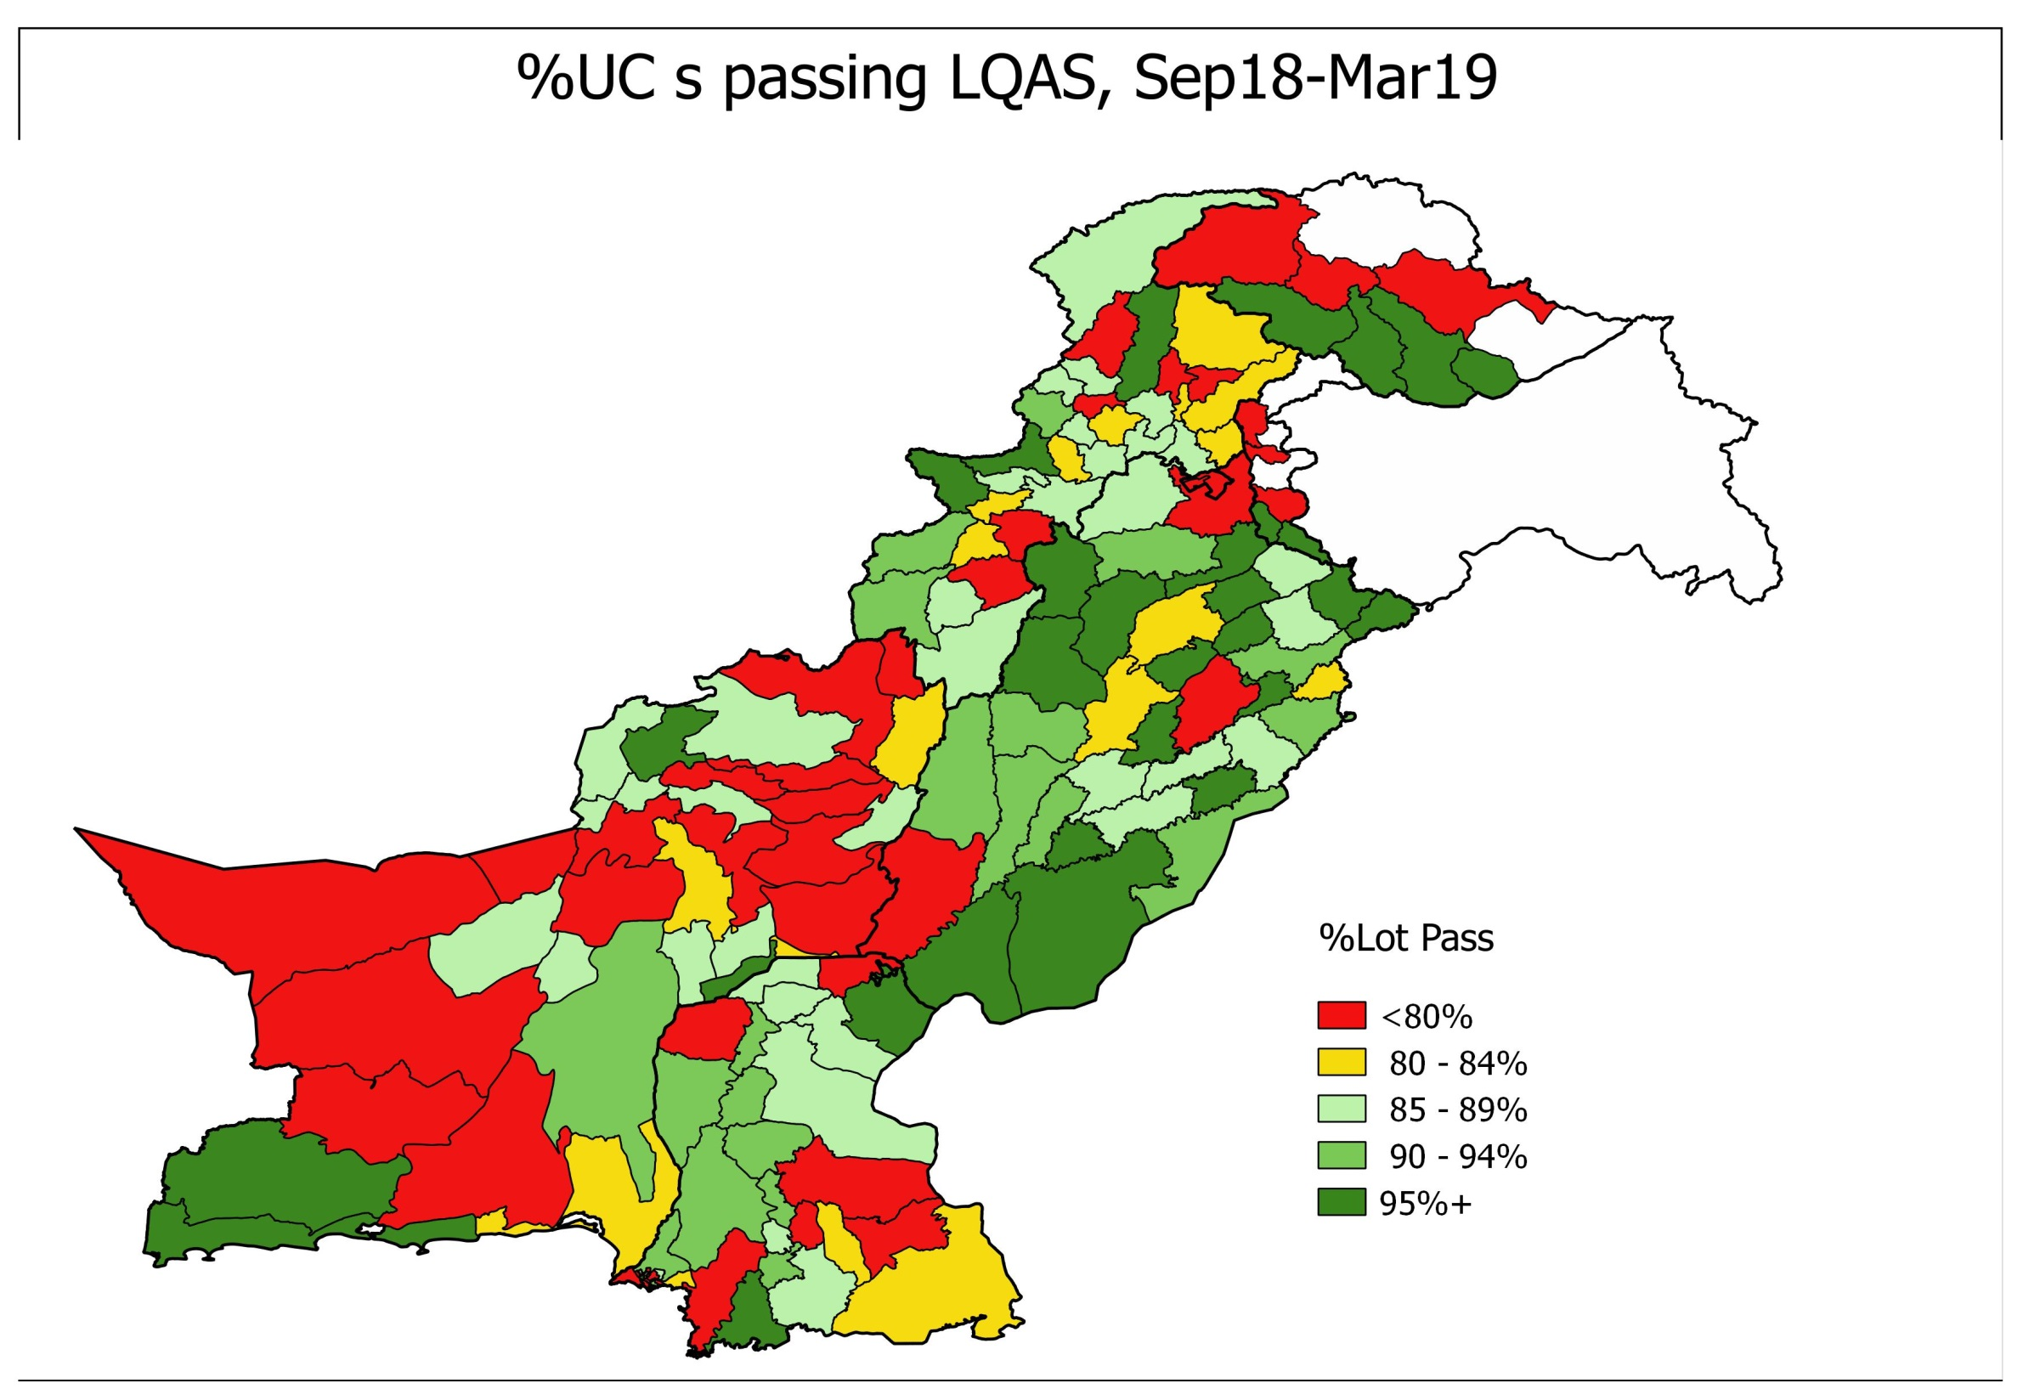

Slide 47
LQAS pass rate – Partner vs Third party
Overall, LQAS pass rate was higher by partner staff compared with third party
LQAS pass rate higher by partner staff in Balochistan, ISB, KP, KPTD, Punjab and Sindh

Slide 48
Reasons for missed children- Partner vs Third party

